Slide 1
Subject-Web Application Development
Class-2
[Building Your First React App, Components in React]
Notes:
1

Slide 2
Content
Building Your First React App
Dealing with JSX
Getting Your React On
Displaying Your Name
It’s All Still Familiar
Changing the Destination
Styling It Up!
Conclusion
Components in React
Quick Review of Functions
Changing How We Deal with UI
Meet the React Component
Creating a Hello, World! Component
Specifying PropertiesFirst Part: Updating the Component Definition
Second Part: Modifying the Component Call
Dealing with Children
Conclusion
4/7/2023
Web Application Development-Class2
2

Slide 3
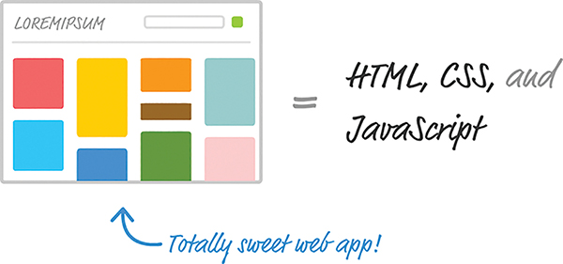
Dealing with JSX
Web apps are built in HTML, CSS, and JavaScript. It doesn’t matter whether your web app was written using
React or some other library, such as Angular, Knockout, or jQuery. The end result has to be some combination of HTML, CSS, and JavaScript; otherwise, your browser really won’t know what to do.
4/7/2023
Web Application Development-Class2
3

Slide 4
Dealing with JSX
Now, here’s where the special nature of React comes in. Besides normal HTML, CSS, and JavaScript, the bulk of your React code will be written in JSX.
JSX is a language that allows you to easily mix JavaScript and HTML-like tags to define user interface (UI) elements and their functionality.
That sounds cool and all, but there’s a slight problem. Your browser has no idea what to do with JSX.
4/7/2023
Web Application Development-Class2
4

Slide 5
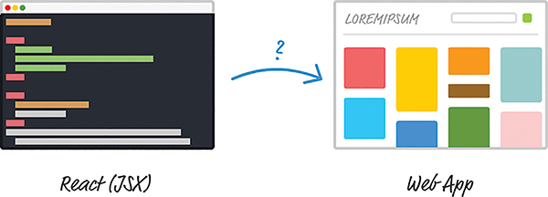
Meet React
To build a web app using React, we need a way to convert our JSX into plain old JavaScript that your browser can Understand.
4/7/2023
Web Application Development-Class2
5

Slide 6
Getting Your React On
JSX needs to turn into something our browser understands. If we don’t do this, our React app simply won’t work.
Fortunately, we have two solutions to this:
Set up a development environment around Node and a handful of build-tools. In this environment, every time you perform a build, all of your JSX is automatically converted into JS and placed on disk for you to reference like any plain JavaScript file.
Let your browser automatically convert JSX to JavaScript at runtime. You specify your JSX directly, just as you would any old piece of JavaScript, and your browser takes care of the rest.
4/7/2023
Web Application Development-Class2
6

Slide 7
Getting Your React On
Your HTML page should look as follows:
<!DOCTYPE html>
<html>
<head>
<meta charset="utf-8">
<title>React! React! React!</title>
<script src="https://unpkg.com/react@16/umd/react.development.js"
></script>
<script src="https://unpkg.com/react-dom@16/umd/reactdom.
development.js"></script>
<script src="https://unpkg.com/babelstandalone@
6.15.0/babel.min.js"></script>
</head>
<body>
<script>
</script>
</body>
</html>
4/7/2023
Web Application Development-Class2
7

Slide 8
Getting Your React On
The below two lines bring in both the core React library and the various things React needs to work with the DOM. Without them, you aren’t building a React app at all.
<script src="https://unpkg.com/react@16/umd/react.development.js"></script>
<script src="https://unpkg.com/react-dom@16/umd/react-dom.development.js"> </script>
Also, we need to reference one more library. Just below these two script tags, add the following line:
<script src="https://unpkg.com/babelstandalone@6.15.0/babel.min.js"></script>
Here you’re adding a reference to the Babel JavaScript compiler. Babel does many cool things, but the one we care about is its capability to turn JSX into JavaScript.
4/7/2023
Web Application Development-Class2
8

Slide 9
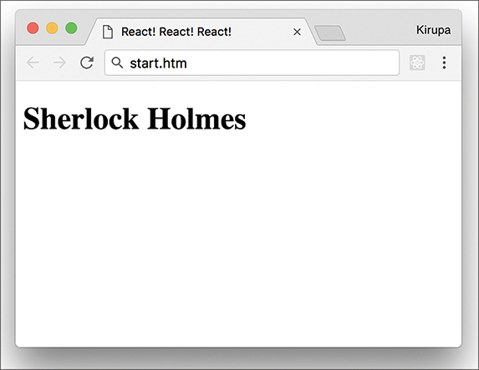
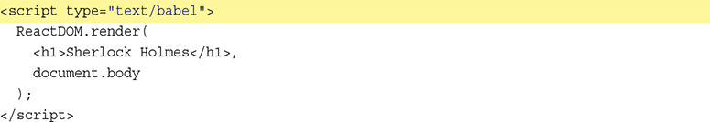
Displaying Your Name
Now you’re going to use React to display your name onscreen. You do that by using a
method called render. Inside your empty script tag in the body, add the following:
4/7/2023
Web Application Development-Class2
9

Slide 10
Changing the Destination
a div element with an id value of container:
<body>
<div id="container"></div>
<script type="text/babel">
ReactDOM.render(
<h1>Batman</h1>,
document.body
);
</script>
</body>
Modify the render method to use it instead of document.body.
ReactDOM.render(
<h1>Batman</h1>,
document.querySelector("#container")
);
Another option is to do some things outside the render method itself:
var destination = document.querySelector("#container");
ReactDOM.render(
<h1>Batman</h1>,
destination
);
4/7/2023
Web Application Development-Class2
10

Slide 11
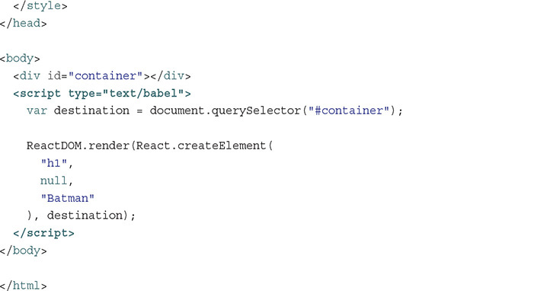
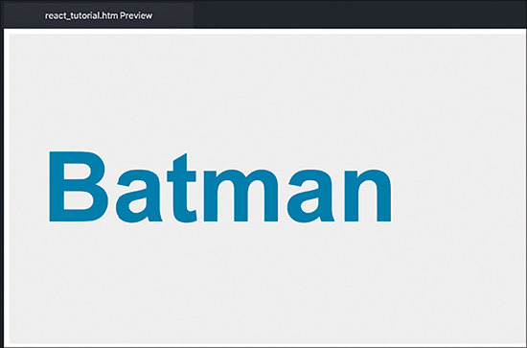
Styling It Up!
The result of adding the CSS.
4/7/2023
Web Application Development-Class2
11

Slide 12
<!DOCTYPE html>
<html>
<head>
<meta charset="utf-8">
<title>React! React! React!</title>
<script src="https://unpkg.com/react@16/umd/react.development.js"
></script>
<script src="https://unpkg.com/react-dom@16/umd/reactdom.
development.js"></script>
<script src="https://unpkg.com/babelstandalone@
6.15.0/babel.min.js"></script>
<style>
#container {
padding: 50px;
background-color: #EEE;
}
#container h1 {
font-size: 144px;
font-family: sans-serif;
color: #0080A8;
}
</style>
</head>
<body>
<div id="container"></div>
<script type="text/babel">
var destination = document.querySelector("#container");
ReactDOM.render(React.createElement(
"h1",
null,
"Batman"
), destination);
</script>
</body>
</html>

Slide 13
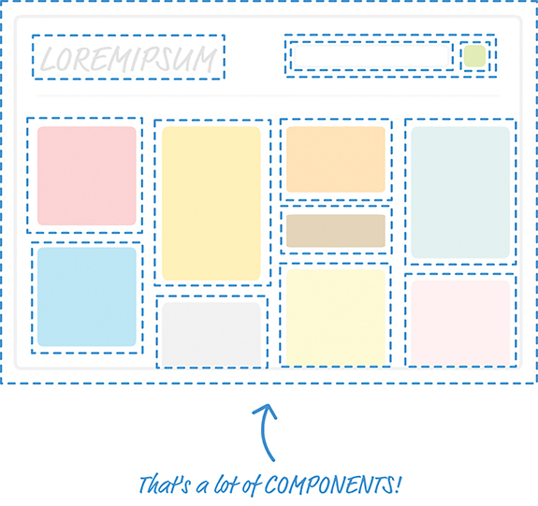
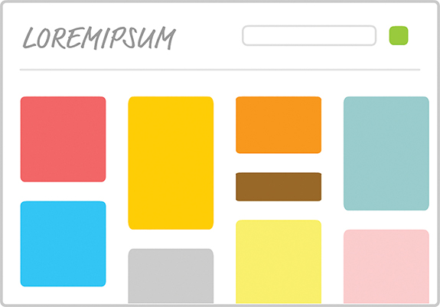
Components in React
Components are one of the pieces that make react, well, React! They’re one of the primary ways you have for defining the visuals and interactions that make up what people see when they use your app.
Your hypothetical finished app.
Diagrammatic representation of the app Components:Each dotted line represents an individual component that is responsible for both what you see and any interactions that it is responsible for.
4/7/2023
Web Application Development-Class2
13

Slide 14
Thank You
4/7/2023
Web Application Development-Class2
14
Notes:
14

